Slide 1
מס' פרויקט:
20-1-1-2187
שם הפרויקט: מימוש וסימולציה של מאיץ למערכות לומדות על רכיב FPGA
מגישים: שי צבר 208723627 חיים גרודה 312562721 מנחה:
יוני זייפרט
מקום ביצוע:
אוניברסיטה

Slide 2
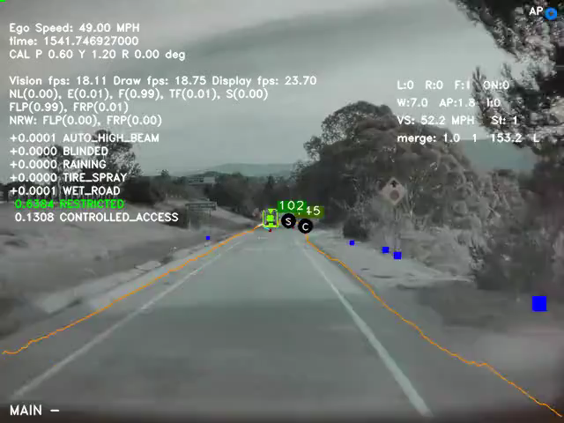
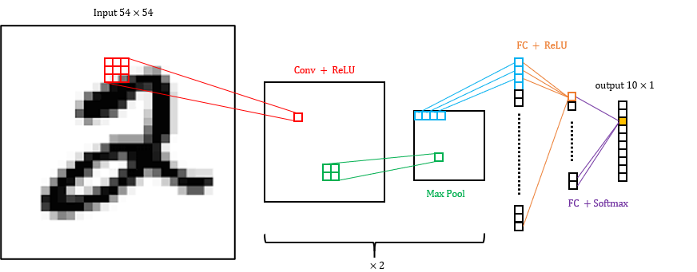
CNN – Convolutional Neural Network
Achieved great success in image classification, speech recognition and more.
Research hotspot in many scientific fields.
Widely used in the industry, such as for autonomous cars, security systems, health and more.
CNN Structure
Convolution – Feature extraction using filters
Activation – Introduce nonlinearity
Pooling – Reduce spatial dimensions
Fully Connected – Neural network (matrix multiplications)
Video: Tesla computer vision
Figure: Implemented CNN model

Slide 3

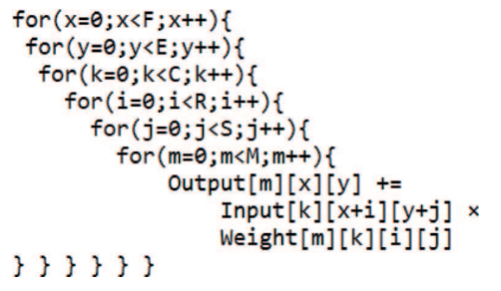
Motivation and Objectives
Motivation
High accuracy comes with long computation time. Approx. 90% of CNN computations are in the convolutional layers
Computation resources cause high-power consumption
The need to include such image recognition capabilities in embedded systems with tight real-time and power constraints
Objectives
Acceleration – by hardware parallelization
Accuracy – reduce loss due to fixed point arithmetic
Power – dedicated hardware processing elements
Figure: 2D convolution. [source]
Figure: Nested ‘for’ loop for convolution calculation

Slide 4
Method
CNN Model
Classification network
Output vector of size 10
Input image 54x54 pixels
6 layers deep
ZedBoard FPGA
Zynq-7000 SoC
Programmable logic (FPGA)
Processing Subsystem (CPU)
Vivado development tools
Fixed Point Calculations:
Better computation time
Less hardware resources
Possible loss of accuracy
High Level Synthesis (HLS)
RTL abstraction
Focus on functionality
Easily explore algorithmic changes
Simple platform retargeting
Figure: The implemented CNN classifying a handwritten digit

Slide 5
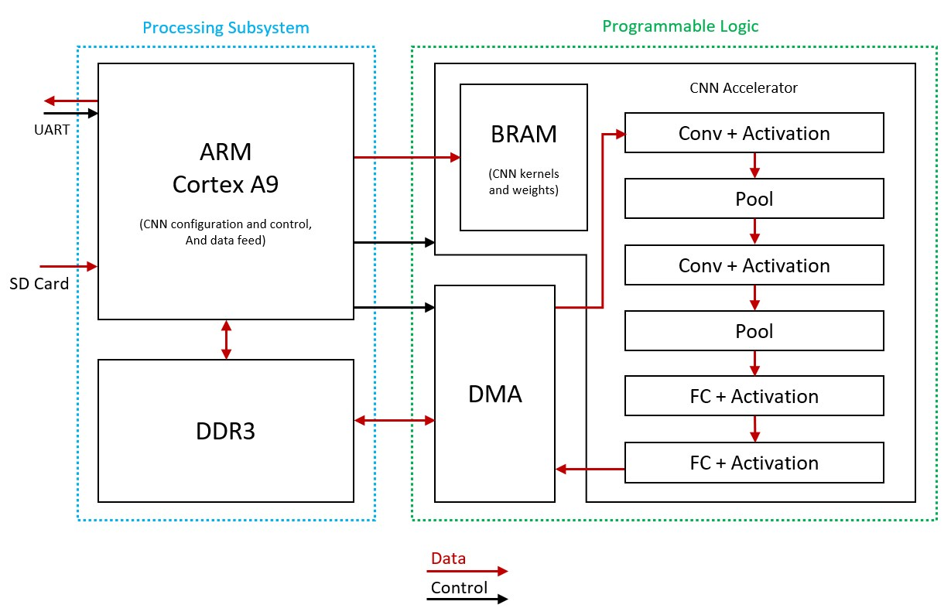
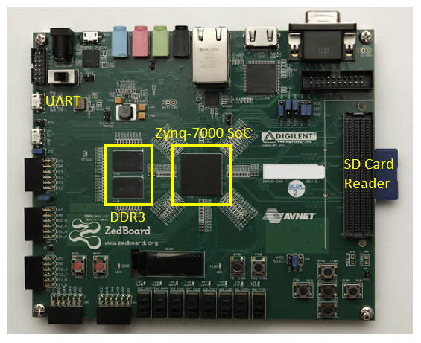
Hardware Design
Processing system (PS):
ARM Cortex A9 667MHz CPU
Input Output – SD card, UART
Control and configuration
DDR memory unit
Programmable Logic (PL):
Artix-7 FPGA with 6.6M logic cells
DMA controller for data transfer
Processing Element per CNN layer
BRAM for kernels and weights
AXI interfaces
Stream – high throughput (input data)
Lite – static data (kernel/weights)

Slide 6
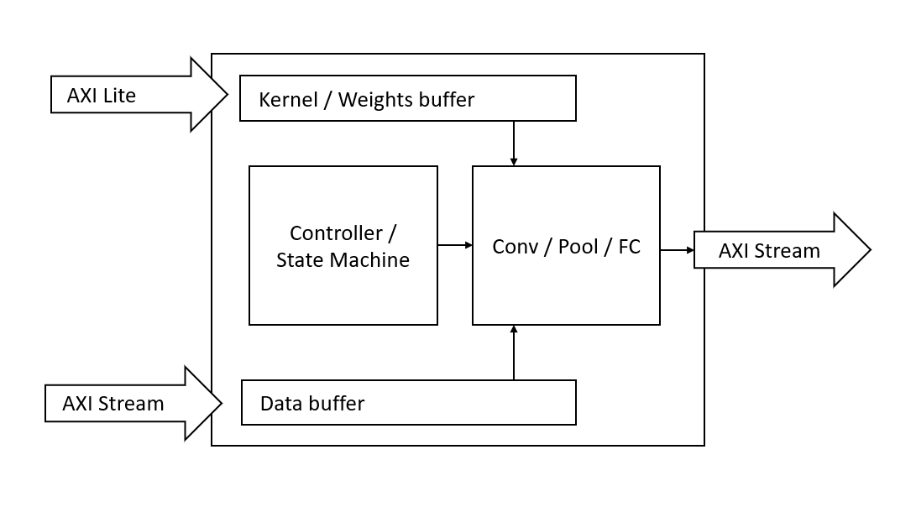
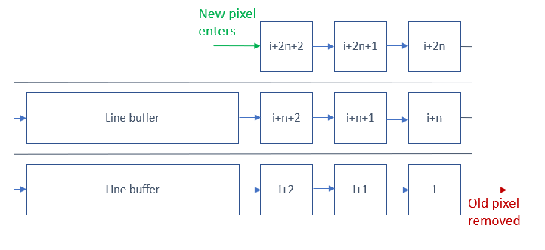
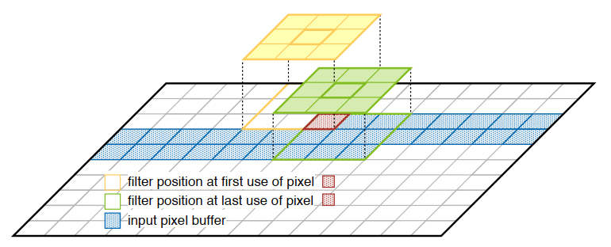
Hardware Design
Processing Element
Implements single CNN layer
Includes BRAM buffers
AXI List/Stream interfaces
FIFO implementation
Max/Avg pooling support
ReLU activation support
Auto generate HLS sources
Auto generate Vivado designs
Sliding Window
Neighborhood extraction
Included per CONV/POOL PE
Data reuse – Pixel transferred once
Memory utilization
Figures: Processing Element design
Figures: Data reuse / sliding window illustration

Slide 7
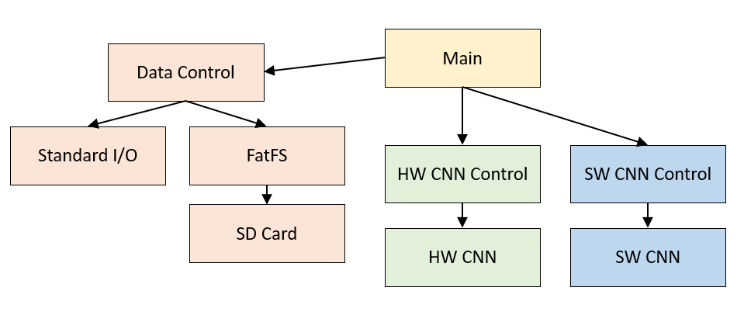
Software Design
Cross platform: PC and FPGA
Written in C in Vivado SDK
Software implementation of CNN
Hardware control modules
Data control and statistics
FPGA platform (ARM Cortex A9 CPU)
Bare Metal (no OS)
FatFS – Free file system software module
SD Card / UART I/O interfaces
HAL headers generated by Vivado
PC platform (Intel i7 CPU)
Linux based
Single threaded
Standard I/O interfaces
Include simulation of HW calculations

Slide 8
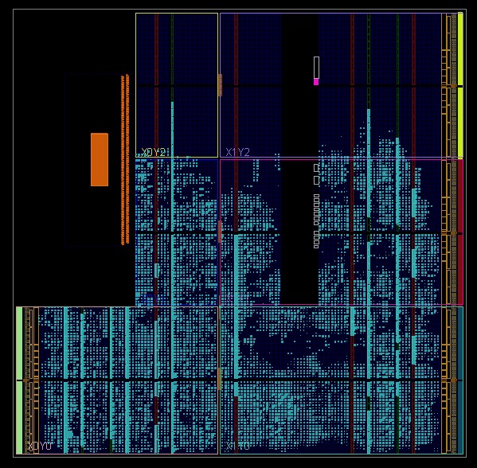
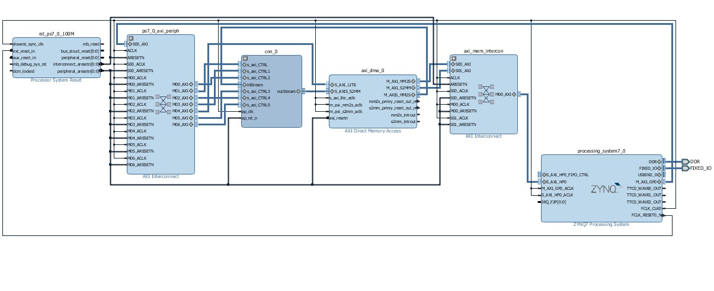
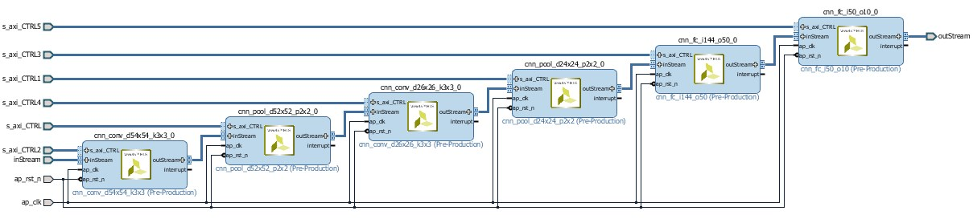
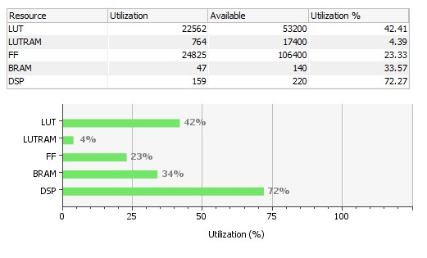
HW Implementation
CNN Core
DMA Engine
Processing System
Figure: TOP block design
Figure: Implemented Design
Table: FPGA utilization
Figure: CNN core block design

Slide 9
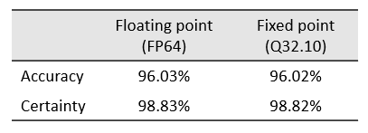
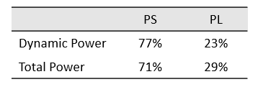
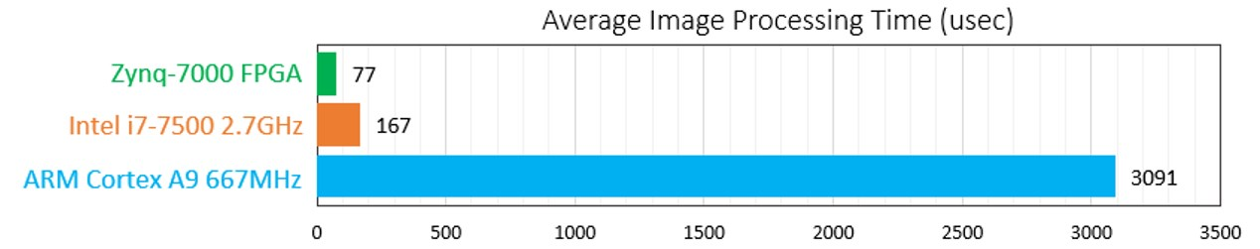
Simulation Results
CNN Simulation
Python Keras deep learning library
MNIST dataset, 10K test images
Kernels and weights fed to CNN
Table: CNN accuracy using different arithmetic
Measurements
Statistics gathered by software
Image processing time
Result accuracy
CNN classification certainty
Vivado power estimation tool
Table: Vivado power estimation results
Table: Time comparison

Slide 10
Conclusions and Future Work
Conclusions
Significant acceleration compared to SW
Possible to keep accuracy also with fixed point
Significant power conservation
Future Work
Add convolution channels (RGB)
Utilize second ARM core of the Zynq-7000 SoC
Compare HW with multi threaded SW implementation
Test accuracy loss for small fixed-point words
Fully automate Vivado design generation

Slide 11
Appendix and References
Project repository on GitHub
ZynqNet - An FPGA-Accelerated Embedded CNN
Science Direct - Convolutional Neural Networks

